Slide 1
Low Vision
Don Higgins Mentor
Mayo-Clinic-Connect
January 30, 2025
Low vision refers to vision loss that cannot be corrected
by medical or surgical treatments or conventional eyeglasses.
A person with low vision must learn to adjust to it.

Slide 2
My History
  20/20 vision until age 38
  Nuclear cataracts within 6 months
  Retina detachments in both eyes
  Buckle surgery in both eyes
  Multiple laser surgeries
  Onset of glaucoma at age 45

Slide 3
Glaucoma for Over 35 Years
  Multiple eye drops daily
  Quarterly eye exams by Ophthalmologist
  For me pressure of 10 is good, 15 is too high
  Loss of central vision in left eye
  Loss of upper 50% of field in right eye
  Partial color blindness

Slide 4
Adapting to Low Vision
Gave up driving 15 years ago
Referred to Florida Lighthouse for the Blind
Learned to use white walking stick when alone
Use goose neck lamp to shine bright light on documents
Listen to audio books via hearing aides
Wear cap with visor to cut down glare
Received low vision physical therapy

Slide 5
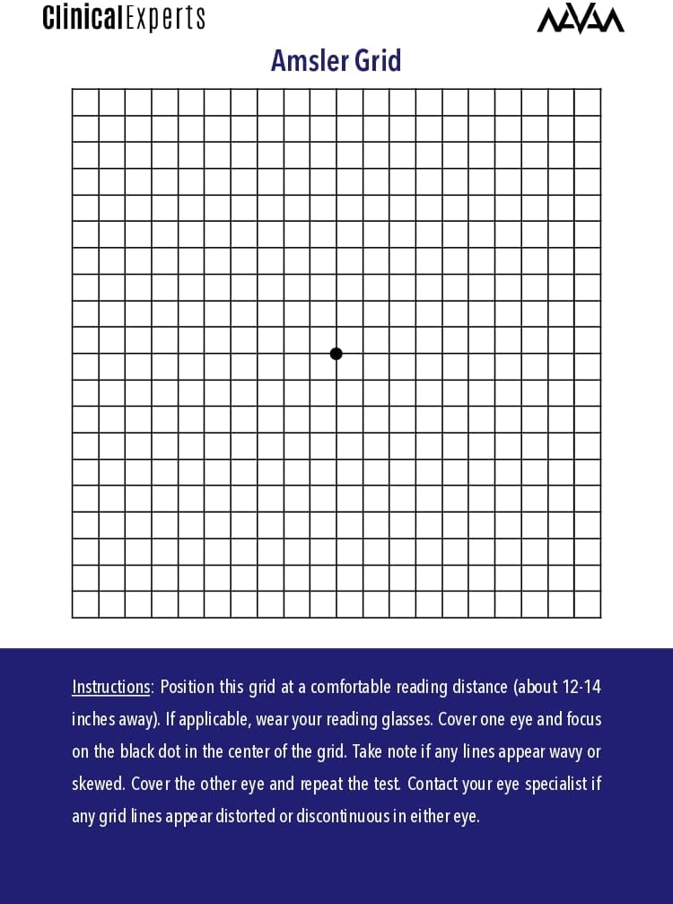
Amsler Grid to check field

Slide 6
Low Vision Physical Therapy
Field tests like Amsler Grid can identify lost field
When I focus on center dot, I can’t see upper half
Exercise right eye to see more in all directions
Read words on sheet in multiple directions
Match cards in hand with stacks on table by number

Slide 7
Most helpful accommodations
Holding hands with Charlotte when walking to avoid tripping
Have Charlotte identify people around us in dim light
Have Charlotte specify which direction to look for something
Have Charlotte tell me when someone is holding out hand
Always carry pocket pin light to read documents
Mayo-Clinic-Connect online open discussion group
Periodically visit eye research center to learn what’s new

Slide 8
Mayo Clinic Connect Open Online Service
Join Mayo Clinic Connect online discussion groups
Mayo-Clinic-Connect members 264,000
Additional new members 14,000 in 2024
Over 1.7 million online sessions in December 2024
Currently there are 28 Mayo Clinic Connect Mentors
Currently there are 3 Mayo Clinic Connect Moderators

Slide 9
Top Eye Research Centers
Bascom Palmer Eye Institute – Miami
Wills Eye Hospital – Philadelphia
Wilmer Eye Institute – Baltimore
Mass Eye and Ear – Boston
Stein and Doheny Eye Institutes – Los Angeles

Slide 10
Questions
What is Next
New medications
New possible surgeries
Mayo Clinic Eye Research
Mayo Clinic Eye Condition Groups

